Slide 1
2
Introduction to C Programming
Objectives
In this chapter, you’ll:
Write simple C programs.
Use simple input and output statements.
Use the fundamental data types.
Learn computer memory concepts.
Use arithmetic operators.
Learn the precedence of arithmetic operators.
Write simple decision-making statements.
Begin focusing on secure C programming practices.

Slide 2
2.1 Introduction
The C language facilitates a structured and disciplined approach to computer-program design.
We introduce structured programming—a methodology that will help you produce clear, easy-to-maintain programs.

Slide 3
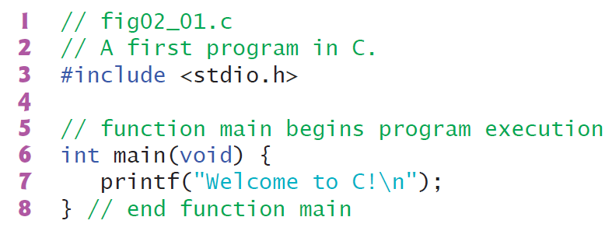
2.2 A Simple C Program: Printing a Line of Text

Slide 4
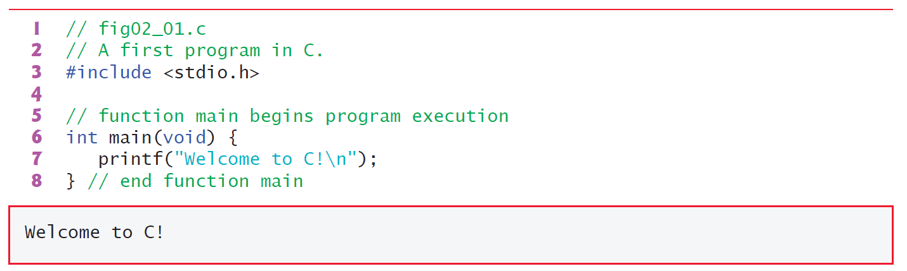
2.2 A Simple C Program: Printing a Line of Text
Comments
Lines 1 and 2
// fig02_01.c
// A first program in C.
#include Preprocessor Directive
Line 3
#include <stdio.h>
is a C preprocessor directive. The preprocessor handles lines beginning with # before compilation. Line 3 tells the preprocessor to include the contents of the standard input/output header (<stdio.h>).

Slide 5
2.2 A Simple C Program: Printing a Line of Text
The main Function
Line 6
int main(void) {...}
main function is a necessary part of every C program.
The parentheses after main indicate that main is a program building block called a function. C programs consist of functions, one of which must be main.
Every program begins executing at the function main.
Functions can return information. The keyword int to the left of main indicates that main “returns” an integer (whole number) value.
Functions also can receive information when they’re called upon to execute. The void in parentheses here means that main does not receive any information.

Slide 6
2.2 A Simple C Program: Printing a Line of Text
A left brace, {, begins each function’s body
(end of line 6). A corresponding right brace, },
ends each function’s body (line 8).
An Output Statement
Line 7
printf("Welcome to C!\n");
Line 7 instructs the computer to perform an action, namely, to display on the screen the string of characters enclosed in the quotation marks.
A string is sometimes called a character string, a message or a literal.
The entire line 7—including the “call” to the printf function to perform its task, the printf’s argument within the parentheses and the semicolon (;)—is called a statement.
Every statement must end with a semicolon statement terminator.

Slide 7
2.1 A Simple C Program: Printing a Line of Text
The “f” in printf stands for “formatted.” When line 7 executes, it displays the message Welcome to C! on the screen.
The characters usually print as they appear between the double quotes but notice that the characters \n were not displayed.
Escape Sequences
In a string, the backslash (\) is an escape character. It indicates that printf should do something out of the ordinary.
In a string, the compiler combines a backslash with the next character to form an escape sequence.
The escape sequence \n means newline.

Slide 8
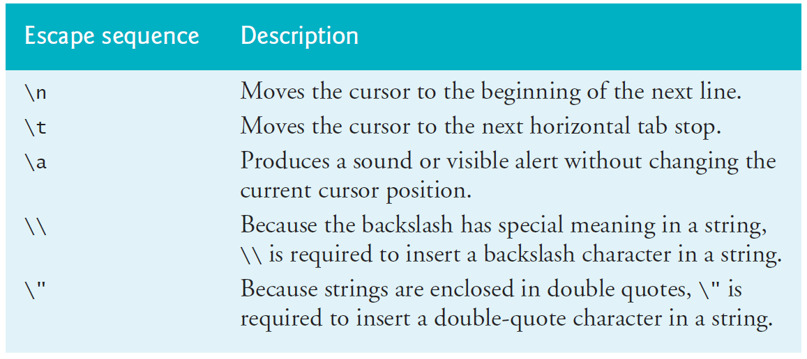
2.2 A Simple C Program: Printing a Line of Text
Escape Sequences

Slide 9
2.2 A Simple C Program: Printing a Line of Text
Indentation Conventions
Indent the entire body of each function one level of indentation (we recommend three spaces) within the braces that define the function’s body.
This indentation emphasizes a program’s functional structure and helps make them easier to read.

Slide 10
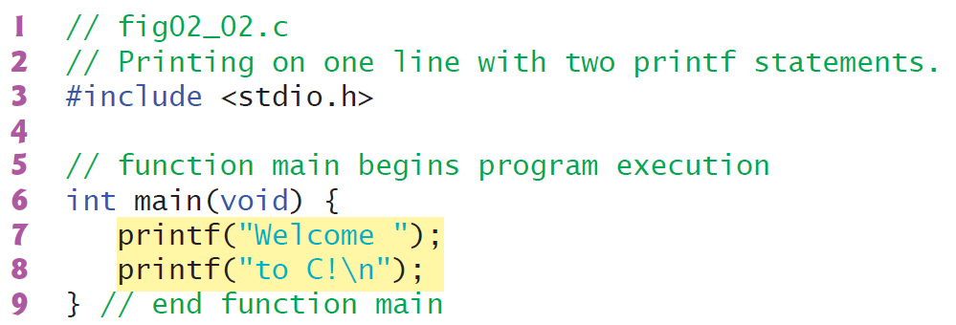
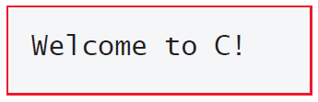
2.2 A Simple C Program: Printing a Line of Text
Using Multiple printfs

Slide 11
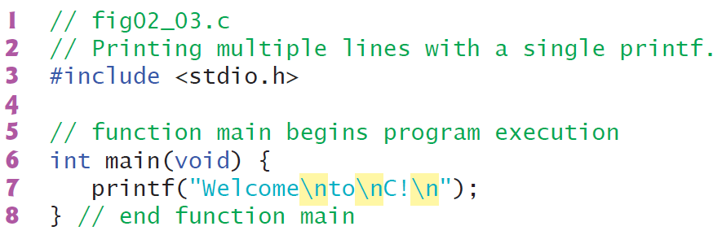
2.2 A Simple C Program: Printing a Line of Text
Displaying Multiple Lines with a Single printf

Slide 12
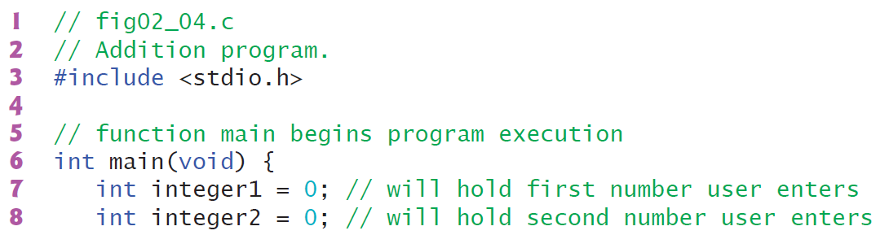
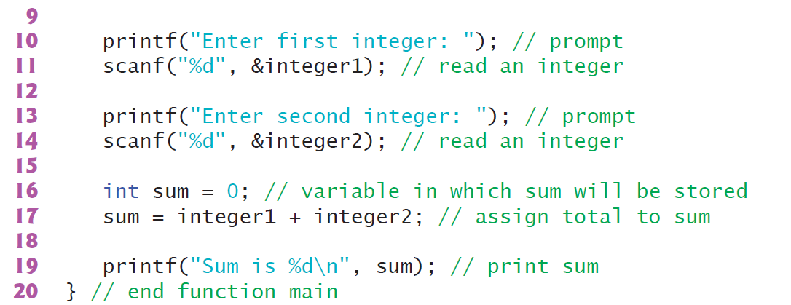
2.3 Another Simple C Program: Adding Two Integers

Slide 13
2.3 Another Simple C Program: Adding Two Integers

Slide 14
2.3 Another Simple C Program: Adding Two Integers

Slide 15
2.3 Another Simple C Program: Adding Two Integers
Define Variables Before They Are Used
All variables must be defined with a name and a type before they can be used in a program.
You can place each variable definition anywhere in main before that variable’s first use in the code.
Identifiers and Case Sensitivity
A variable name can be any valid identifier. Each identifier may consist of letters, digits and underscores (_), but may not begin with a digit.
C is case sensitive, so a1 and A1 are different identifiers.
A variable name should start with a lowercase letter.
Choosing meaningful variable names helps make a program self-documenting, so fewer comments are needed.
Avoid starting identifiers with an underscore (_)

Slide 16
2.3 Another Simple C Program: Adding Two Integers
Identifiers and Case Sensitivity
Multiple-word variable names can make programs more readable. For such names separate the words with underscores, as in total_commissions, or
run the words together and begin each subsequent word with a capital letter, as in totalCommissions.
The latter style is called camel casing because the pattern of uppercase and lowercase
letters resembles a camel’s silhouette. We prefer camel casing.

Slide 17
2.3 Another Simple C Program: Adding Two Integers
The scanf Function and Formatted Inputs
scanf is used to obtain a value from the user.
The function reads from the standard input, which is usually the keyboard.
The “f” in scanf stands for “formatted.” This scanf has two arguments—"%d“ and &integer1.
The "%d" is the format control string. It indicates the type of data the user should enter.
The %d conversion specification specifies that the data should be an integer—the d stands for “decimal integer”.
scanf’s second argument begins with an ampersand (&) followed by the variable name.
The & is the address operator and, when combined with the variable name, tells scanf the location (or address) in memory of the variable integer1. scanf then stores the value the user enters at that memory location.

Slide 18
2.3 Another Simple C Program: Adding Two Integers
Assignment Statement
sum = integer1 + integer2; // assign total to sum
Binary Operators
The = operator and the + operator are binary operators—each has two operands.

Slide 19
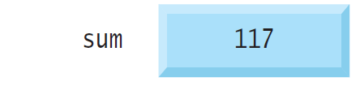
2.4 Memory Concepts
Every variable has a name, a type, a value and a location in the computer’s memory.

Slide 20
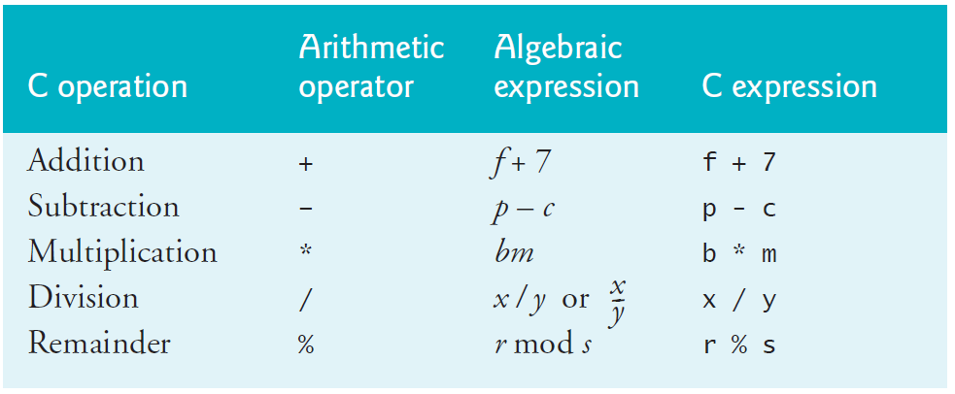
2.5 Arithmetic in C
Most C programs perform calculations using the following binary arithmetic operators:

Slide 21
2.6 Decision Making: Equality and Relational Operators
Executable statements either perform actions like calculations, input and output, or, as you’re about to see, make decisions.
For example :
A program might determine whether a person’s grade on an exam is greater than or equal to 60, so it can decide whether to print the message “Congratulations! You passed.”
A condition is an expression that can be true (that is, the condition is met) or false (that is, the condition isn’t met).
This section introduces the if statement, which allows a program to make a decision based on a condition’s value. If the condition is true, the statement in the if statement’s body executes; otherwise, it does not.

Slide 22
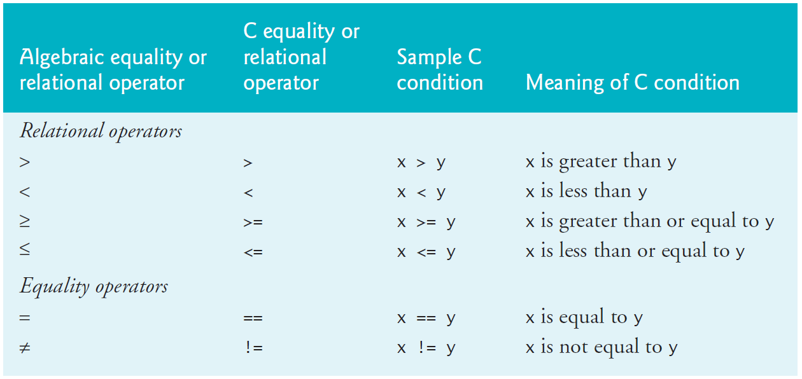
2.6 Decision Making: Equality and Relational Operators
Equality and Relational Operators
Conditions are formed using the following equality and relational operators:

Slide 23
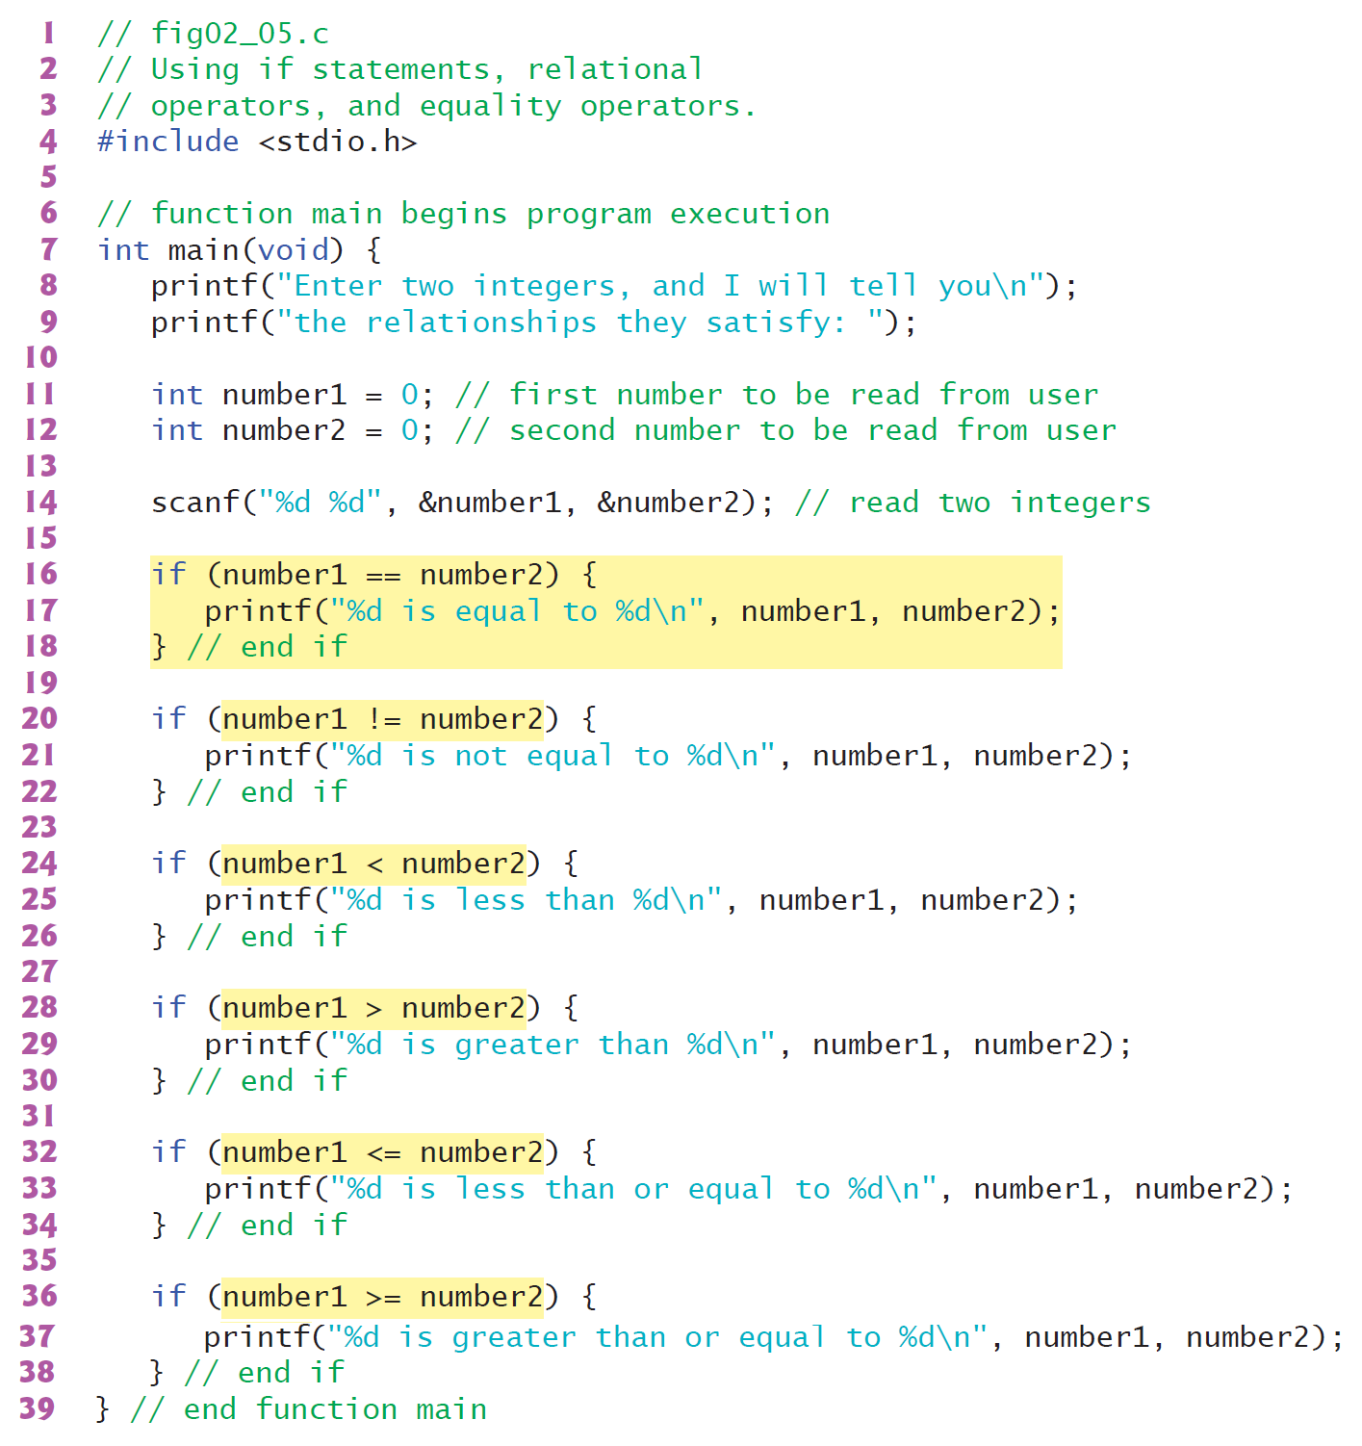
2.6 Decision Making: Equality and Relational Operators

Slide 24
2.6 Decision Making: Equality and Relational Operators

Slide 25
2.6 Decision Making: Equality and Relational Operators

Slide 26
2.6 Decision Making: Equality and Relational Operators

Slide 27
2.6 Decision Making: Equality and Relational Operators

Slide 28
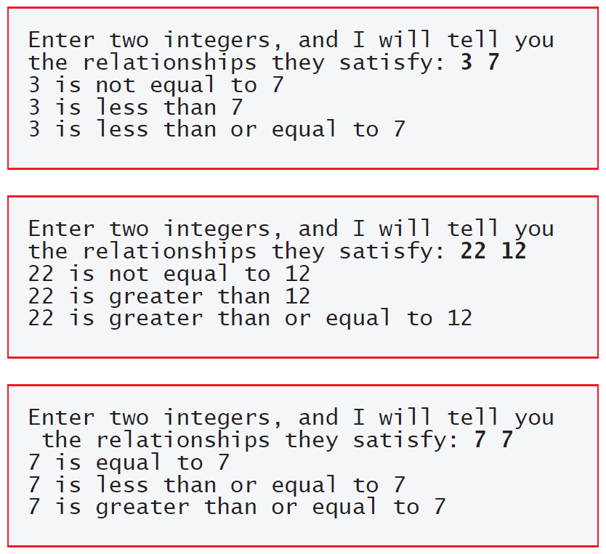
2.6 Decision Making: Equality and Relational Operators

Slide 29
2.6 Decision Making: Equality and Relational Operators

Slide 30
2.6 Decision Making: Equality and Relational Operators

Slide 31
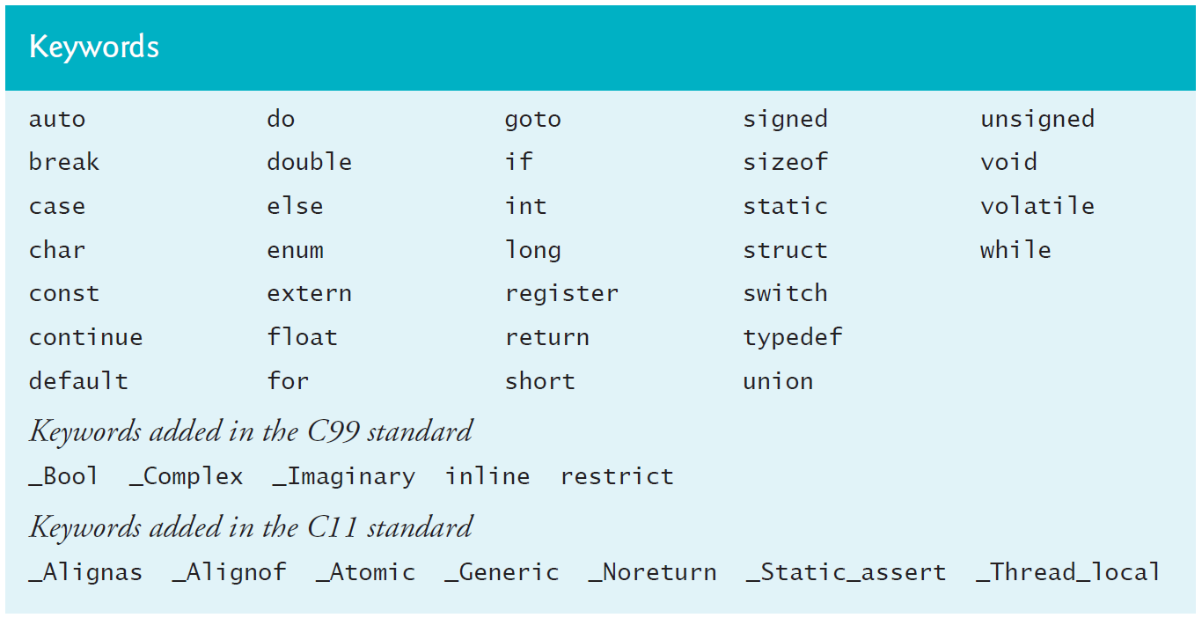
2.6 Decision Making: Equality and Relational Operators
Keywords
Some words that we’ve used in this chapter’s examples, such as int, if and void, are keywords or reserved words of the language and have special meaning to the compiler.

